Slide 1
Why climate models BUG biologists
Nick Smith
BUGS
March 30, 2019

Slide 2
The world is projected to war 4°C by 2100
IPCC (2013)

Slide 3
Says who?
IPCC (2013)

Slide 4
Earth System Models
Dr. Kaitlin Naughten

Slide 5
Why do Biologists care?

Slide 6
Why do Biologists care?
There is a lot of Biology in ESMs

Slide 7
Dr. Kaitlin Naughten

Slide 8
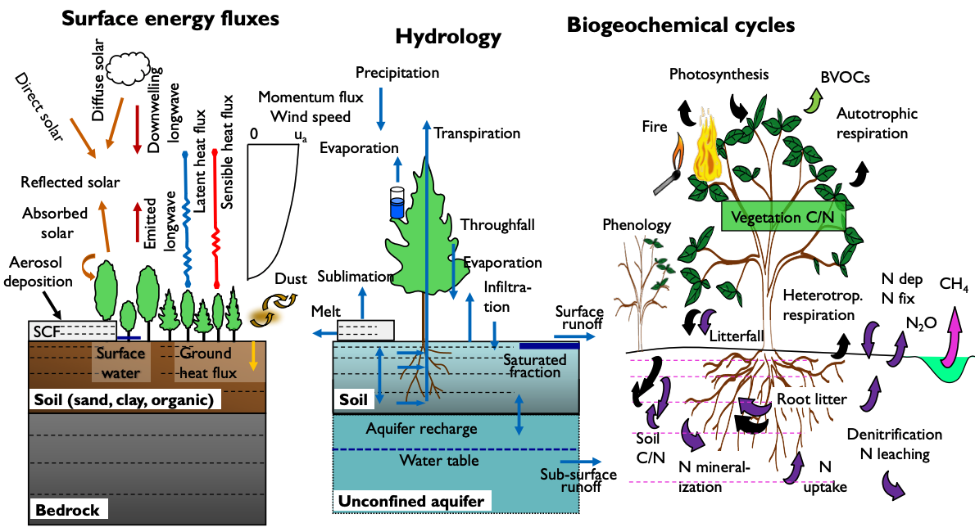
Dave Lawrence (NCAR)

Slide 9
Why do Biologists care?
There is a lot of Biology in ESMs
And that Biology matters!

Slide 10
Soil microbial
respiration
60 PgC/yr
Photosynthesis
120 PgC/yr
Fossil fuel burning
<10 PgC/yr
IPCC (2013)

Slide 11
Why do Biologists care?
There is a lot of Biology in ESMs
And that Biology matters!
There is a lot of Biology missing from ESMs

Slide 12
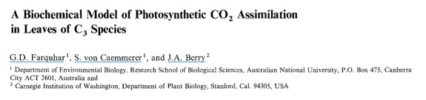
1980’s: plant models are developed

Slide 13
90’s to 2000’s: spinach world!

Slide 14
2000’s: 5 – 10 plant “types”
Broadleaf tree
Needleleaf tree
Deciduous tree
Shrub
Grass

Slide 15
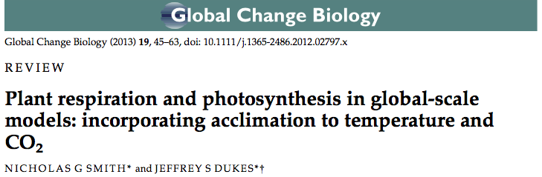
2010’s: “Smart” plants
With time, plants will acclimate to environmental perturbations, such as elevated temperature and CO₂.

Slide 16
Why do Biologists care?
There is a lot of Biology in ESMs
And that Biology matters!
There is a lot of Biology missing from ESMs
…which may or may not matter

Slide 17

2010’s: “Smart” plants
Acclimation reduces plant sensitivity to climate, which increases future evaporative cooling.

Slide 18
Biology in ESMs
Plant “types”
Photosynthesis, respiration, transpiration, nutrient cycling
“Living” soils
Respiration, nutrient cycling
Humans
Not really doing any biology directly; mostly just burning fossil fuels and changing land use

Slide 19
Biology missing from ESMs
Individual species
Animals, bacteria, fungi
Reproduction

Slide 20
Which leads to…
Models should this important process that I measured!

Slide 21
I’m convinced, what do I need to know to get my Biology in an ESM?

Slide 22

Why climate models BUG biologists
Nick Smith
BUGS, March 30, 2019
https://github.com/ESCOMP

